Slide 1
CMPT 276
Project Presentation
TEAM 13
By: Larren Canapi, Matthew Zegar, TJ Le, Mohammad Raad Sarar, Khanh Nam Tang, and Varpreet Dhaliwal
Notes:
Matt Z

Slide 2
Introduction
Create a Chip8 emulator and visualizer that runs Chip8 programs on a modern web browser
Create a software tool that’s useful for Chip8 developers
Create at two Chip8 video games

Slide 3
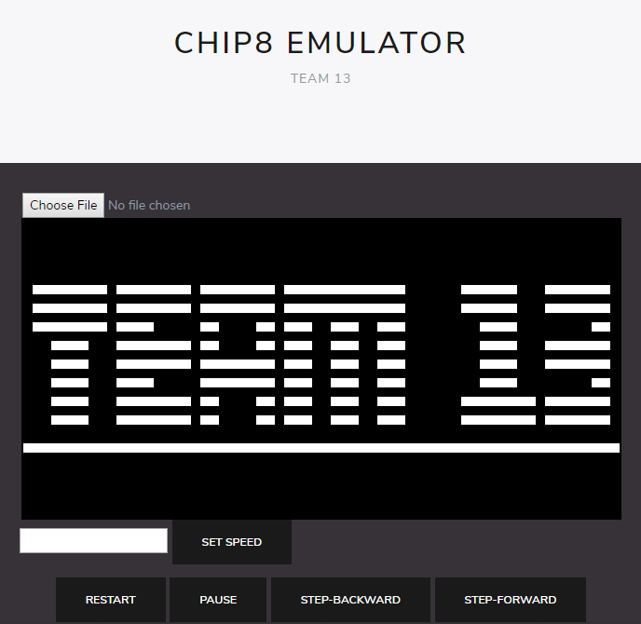
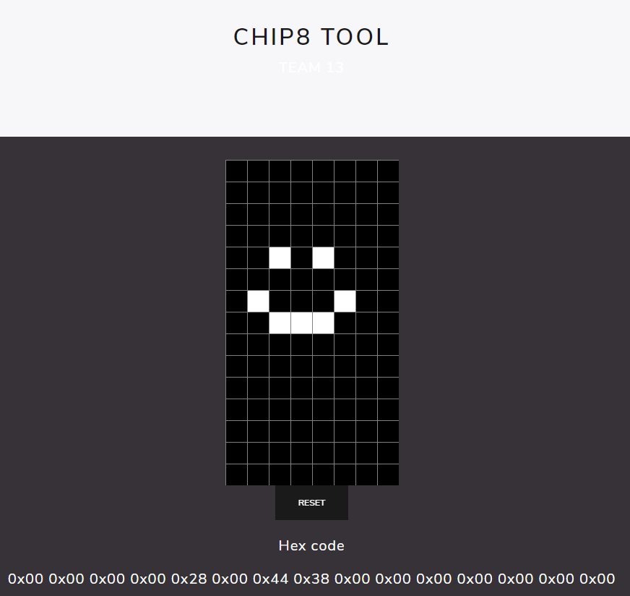


What did we finish?
Chip8 interpreter
Chip8 Sprite Editor
Two Chip8 games

Slide 4
Emulator and Visualizer
Project runs any Chip8 program on a modern web browser
Displays Chip8 program information to the user
Has various ways to manipulate the state of the program
Developer/Educational Use

Slide 5
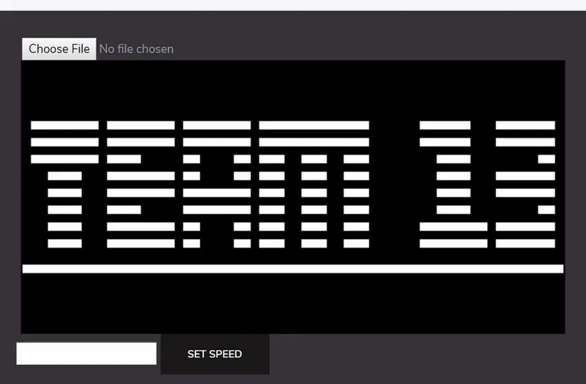
Emulator Features - Loading roms

Slide 6
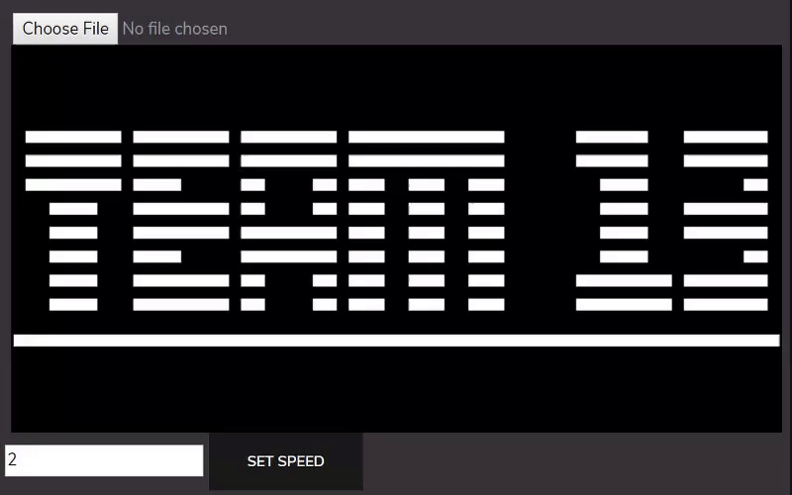
Emulator Features - Settings speed

Slide 7
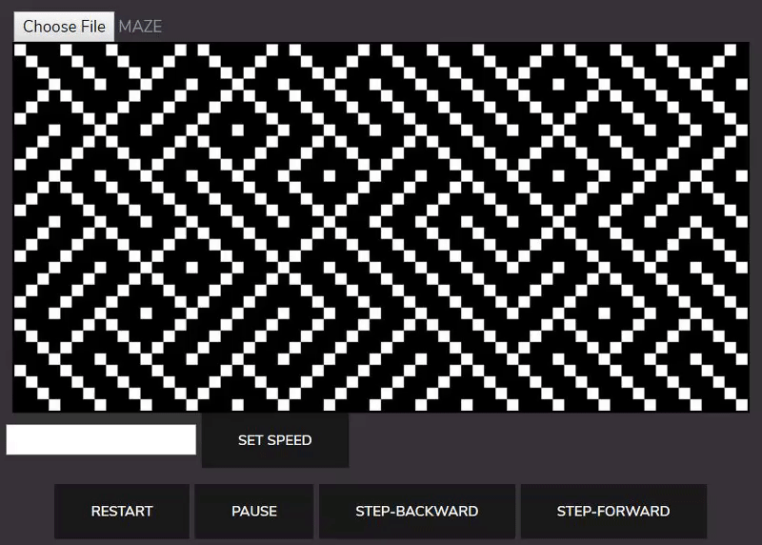
Emulator Features - Restart/Pause

Slide 8
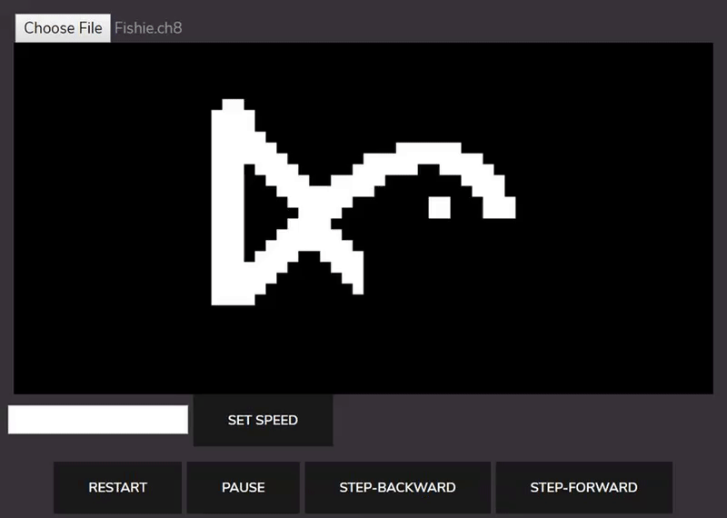
Emulator Features - Step-Forward/Back

Slide 9
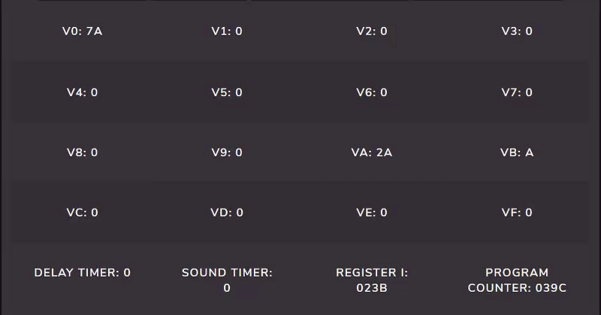
Emulator Features - CPU details

Slide 10

Sprite Editor | Tool
Allows users to design sprites for Chip8 programming
Integrated with the emulator webpage
Converts sprites into usable hexadecimal

Slide 11
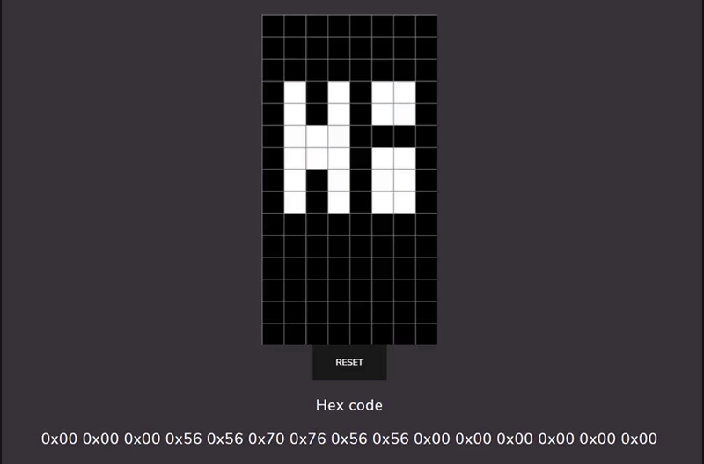
Tool Features - Draw, Reset, Use

Slide 12


Pong | Game 1
We re-created the famous game in Chip8
The game is a first-to-five win condition
2 player game

Slide 13
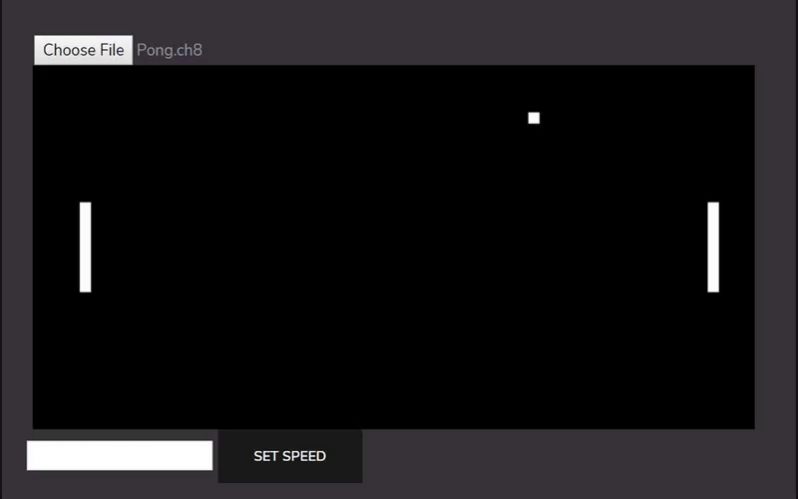
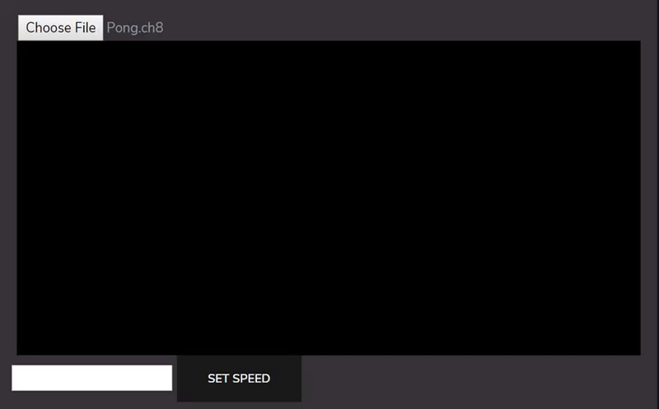
Pong Gameplay

Slide 14

Space Invaders | Game 2
We re-created Space Invaders with a new twist on the gameplay
Team originally wanted to create Breakout but didn’t due to difficulty

Slide 15
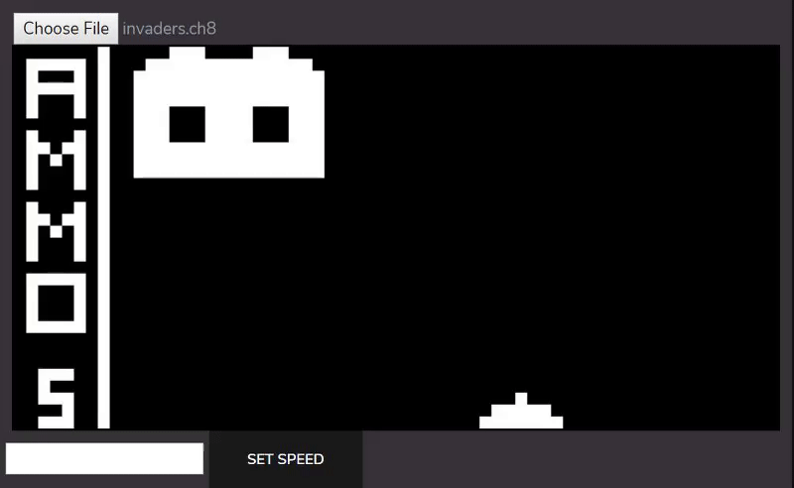
Space Invaders Gameplay

Slide 16
Did we meet our project goals?
We managed to create a Chip8 interpreter that runs on JavaScript
Chip8 Tool that allows users to create sprites
Two Chip8 games
Implementation could be optimized more

Slide 17
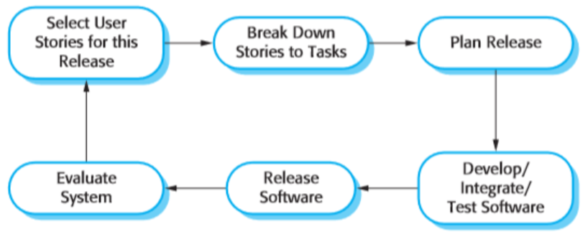
Software Methodology/Techniques
Used Agile Development/Extreme Programming
Peer programming was heavily used
Simple Design with Refactoring
Continuous Integration/communication

Slide 18
Peer Programming Importance
The group struggled to code the emulator in the beginning
Scheduling extra meetings to program together helped
Allowed the group to understand each others skill sets

Slide 19

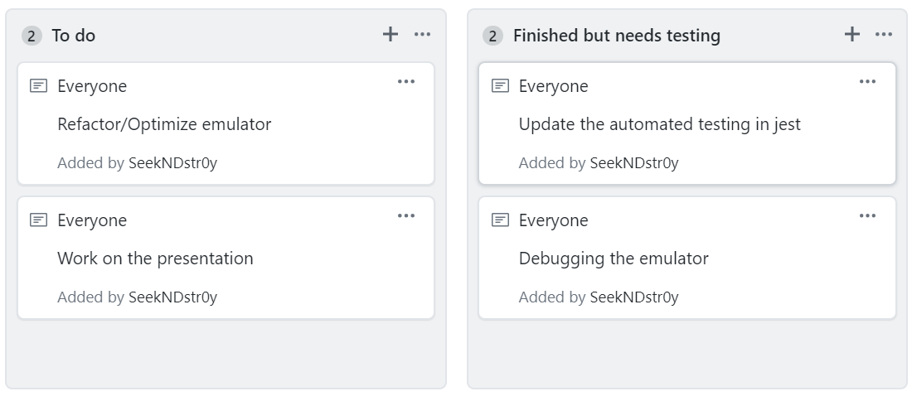
Managing the Project/Group
Discord was used for general communication
Github was as our private repository
Github’s project tab also acted as a Kanban Board for tasks
Weekly meetings in CSIL on Mondays

Slide 20
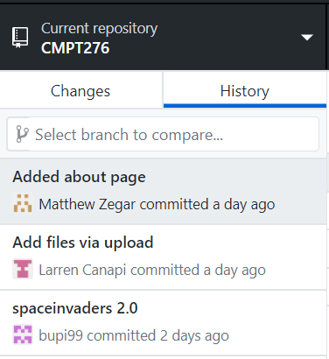
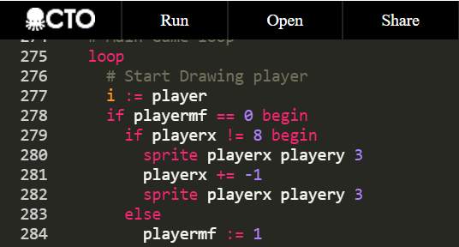
What tools did we try?
The Octo Assembler for easy to write Chip8 programs
Sublime Merge was difficult to use, Github Desktop preferred
Lodash for the step-backwards functionality
Notes:
Talk about how Octo made game coding easy, how sublime merge was difficult to learn/use, and how github desktop made it much easier

Slide 21
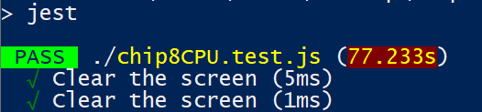
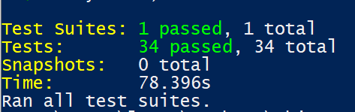
Quality Assurance and Testing
We used Jest for our automated testing
Mainly tested the opcodes in Chip8
Unit/System Testing done throughout the term
Notes:
4:30

Slide 22
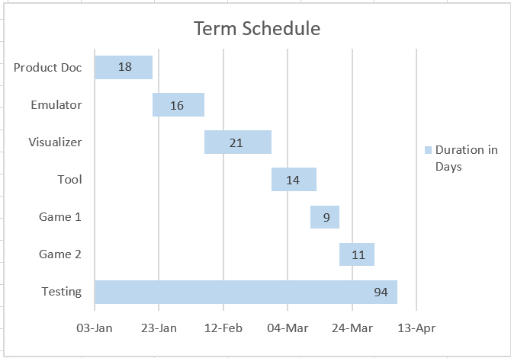
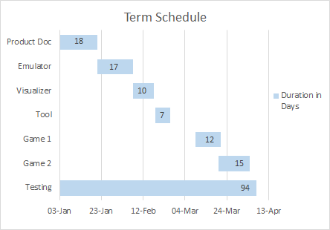
Expected Schedule vs. Actual Schedule
Release 0
Release 4
Notes:
4:24 run 2

Slide 23
Where things went well
Constant meetings every single week was helpful
Our expected timeline was a good basis for planning
Group coding sessions
Good communication/cooperation within the group
Notes:
5:25

Slide 24
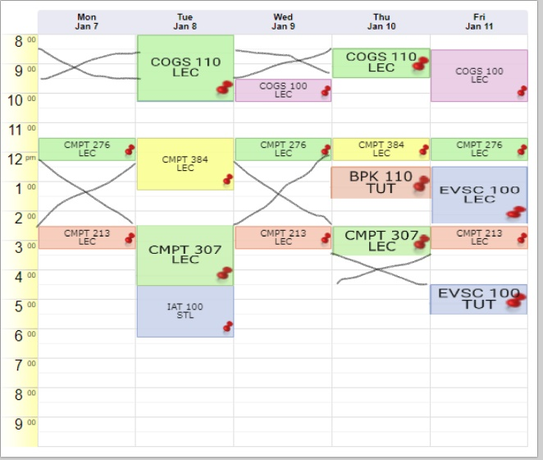
Where things went wrong
Some poor task delegation lead to delays
Group members being busy with other classes

Slide 25


What we learned
Technical aspects like emulation, Javascript, Git
Software engineering tactics like
Agile Development
Management/Communication
Various testing techniques
Notes:
6:00

Slide 26
Advice to future CMPT 276 Students
Schedule meetings where the group codes together
Expect the time it takes to complete tasks to change rapidly
Communicate and understand each group members strengths/weaknesses

Slide 27
Citations and Resources | IEEE
Cowgod's Chip-8 Technical Reference. [Online]. Available: http://devernay.free.fr/hacks/chip8/C8TECH10.HTM. [Accessed: 18-Jan-2019].
“Learn X in Y minutes Where X=javascript,” Learn swift in Y Minutes. [Online]. Available: https://learnxinyminutes.com/docs/javascript/. [Accessed: 18-Jan-2019].
Mattmikolay, “mattmikolay/chip-8,” GitHub. [Online]. Available: https://github.com/mattmikolay/chip-8/wiki/CHIP‐8-Technical-Reference. [Accessed: 18-Jan-2019].
M. Cone, “Basic Syntax,” Cheat Sheet | Markdown Guide. [Online]. Available: https://www.markdownguide.org/basic-syntax/. [Accessed: 18-Jan-2019].
“Welcome,” Emulator 101 - Welcome. [Online]. Available: http://www.emulator101.com/welcome.html. [Accessed: 18-Jan-2019].

Slide 28
Citations and Resources | IEEE
"CHIP-8 Emulator", CHIP-8, 2019. [Online]. Available: https://massung.github.io/CHIP-8/. [Accessed: 21- Jan- 2019]
Lupton, J. Parr, J. Lupton and J. Lupton, "Atari "Pong" is 45 Years Old Today! - Funstock", Funstock, 2019. [Online]. Available: https://www.funstockretro.co.uk/news/atari-pong-is-45-years-old-today/. [Accessed: 21- Jan- 2019]
"Breakout BREAK OUT Brix CloneHackHALFBRICKS David Winter 97 CHIP8 MEGACHIP SUPERCHIP 8 RCA STUDIO II", YouTube, 2019. [Online]. Available: https://www.youtube.com/watch?v=JjCog2aIPVs. [Accessed: 21- Jan- 2019]

Slide 29
Questions?

Slide 30

Thank you

